Slide 1
PROJECT GLADIATOR
Retail Case Study

Slide 2
Team Details
Team Member
Hansika Khadapkar
Nilesh Kumar
Rahul Noronha

Slide 3
Problem Statement
Business Query
The Pricing Summary Report Query provides a summary pricing report for all line items shipped as of a given date. The date is within 60-120 days of the greatest ship date contained in the database.The query lists totals for extended price, discounted extended price, discounted extended price plus tax, average quantity, average extended price, and average discount. These aggregates are grouped by RETURNFLAG and LINESTATUS, and listed in ascending order of RETURNFLAG and LINESTATUS. A count of the number of line items in each group is included.

Slide 4
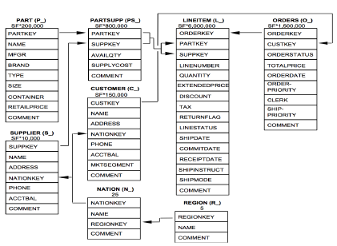
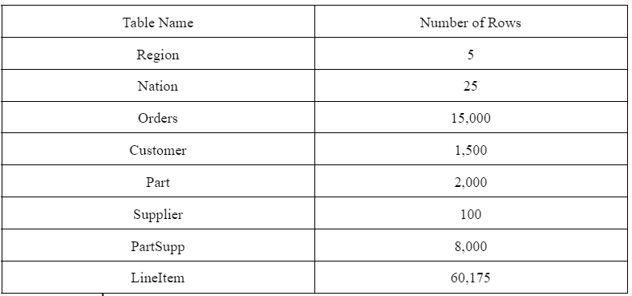
Dataset
Link: https://drive.google.com/drive/folders/1A3YDOT5ONTsyh6tXPOPEe7pQoGM5N3kj?usp=sharing
Description: 1. We download the dataset in CSV format. There are 8 files, one for each table shown in the TPC-H Schema given in Figure 1. 2. In table 2 we can see the sizes of all the 8 tables in the Retail Case Study.
Figure 2. Table sizes
Figure 1. TPC-H Schema

Slide 5






Architecture
Tools Used: Snowflake, Power BI, AWS S3, AWS SQS, SnowCLI.
Description:
Snowflake is a SaaS warehouse and database solution. We use it to store the tables and create views.
AWS S3 bucket is the cloud service provider tool to store data on the cloud.
AWS SQS Simple Queue Service is the service called to notify when a bucket has been loaded with files.
SnowCLI is the tool we use to load into tables using Internal stages. It is a command line tool to run Snowflake.
Snowpipe is the tool we use to load data continuously.
Power BI is the tool we can use to import data and create visualizations on it.

Slide 6
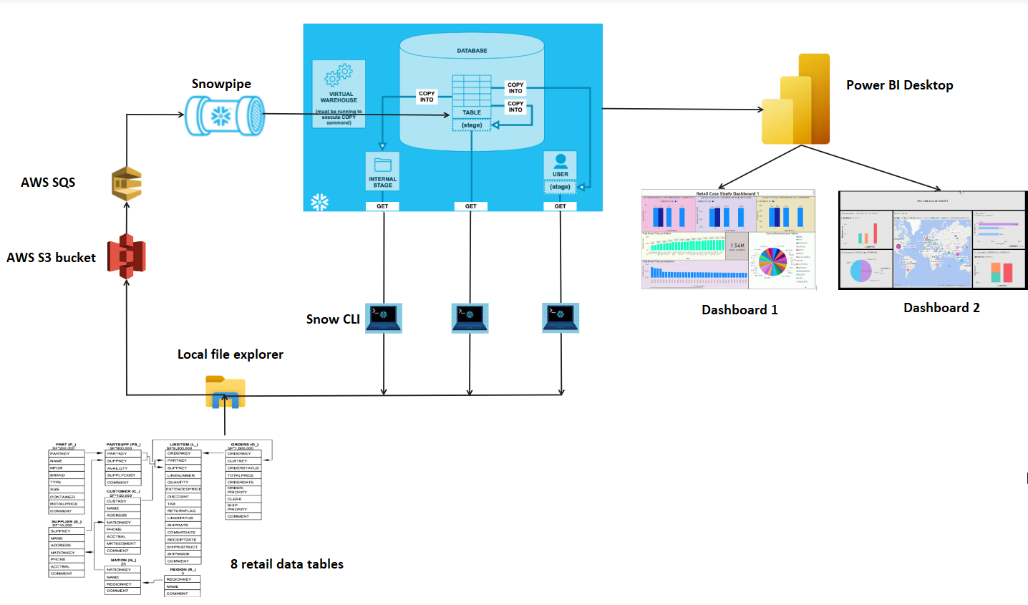
Architecture
Tools Used: Snowflake, Power BI, AWS S3, AWS SQS, SnowCLI.

Slide 7
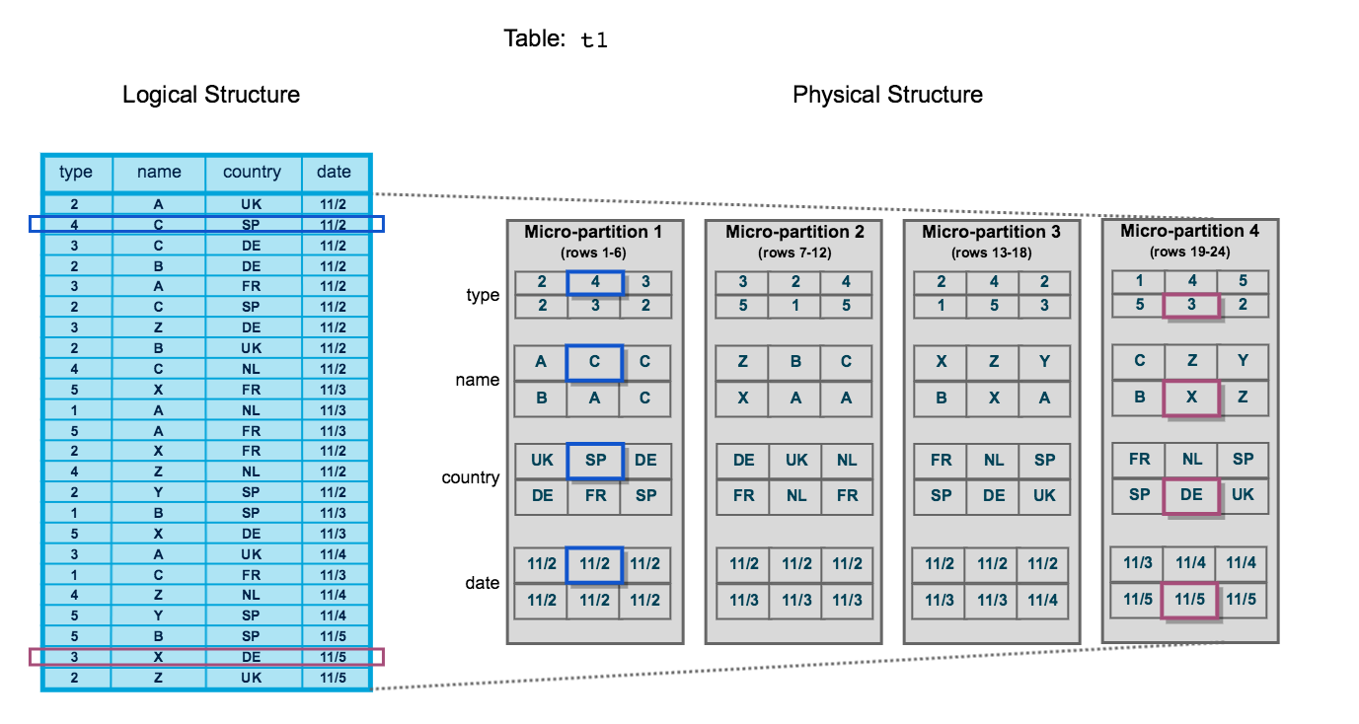
Micro-partitions and Data Clustering
We created 8 tables of the Retail data and added Cluster keys
When data is loaded into table, clustering metadata is collected and recorded for each micro-partition created during the process. Snowflake then leverages this clustering information to avoid unnecessary scanning of micro-partitions during querying, significantly accelerating the performance of queries that reference these columns.

Slide 8
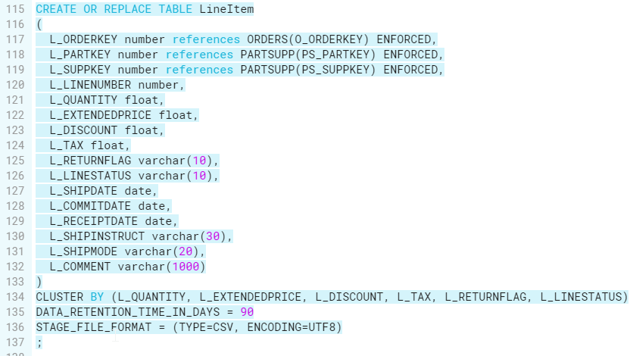
Cluster Key Choice
Table definition for LineItem table

Slide 9
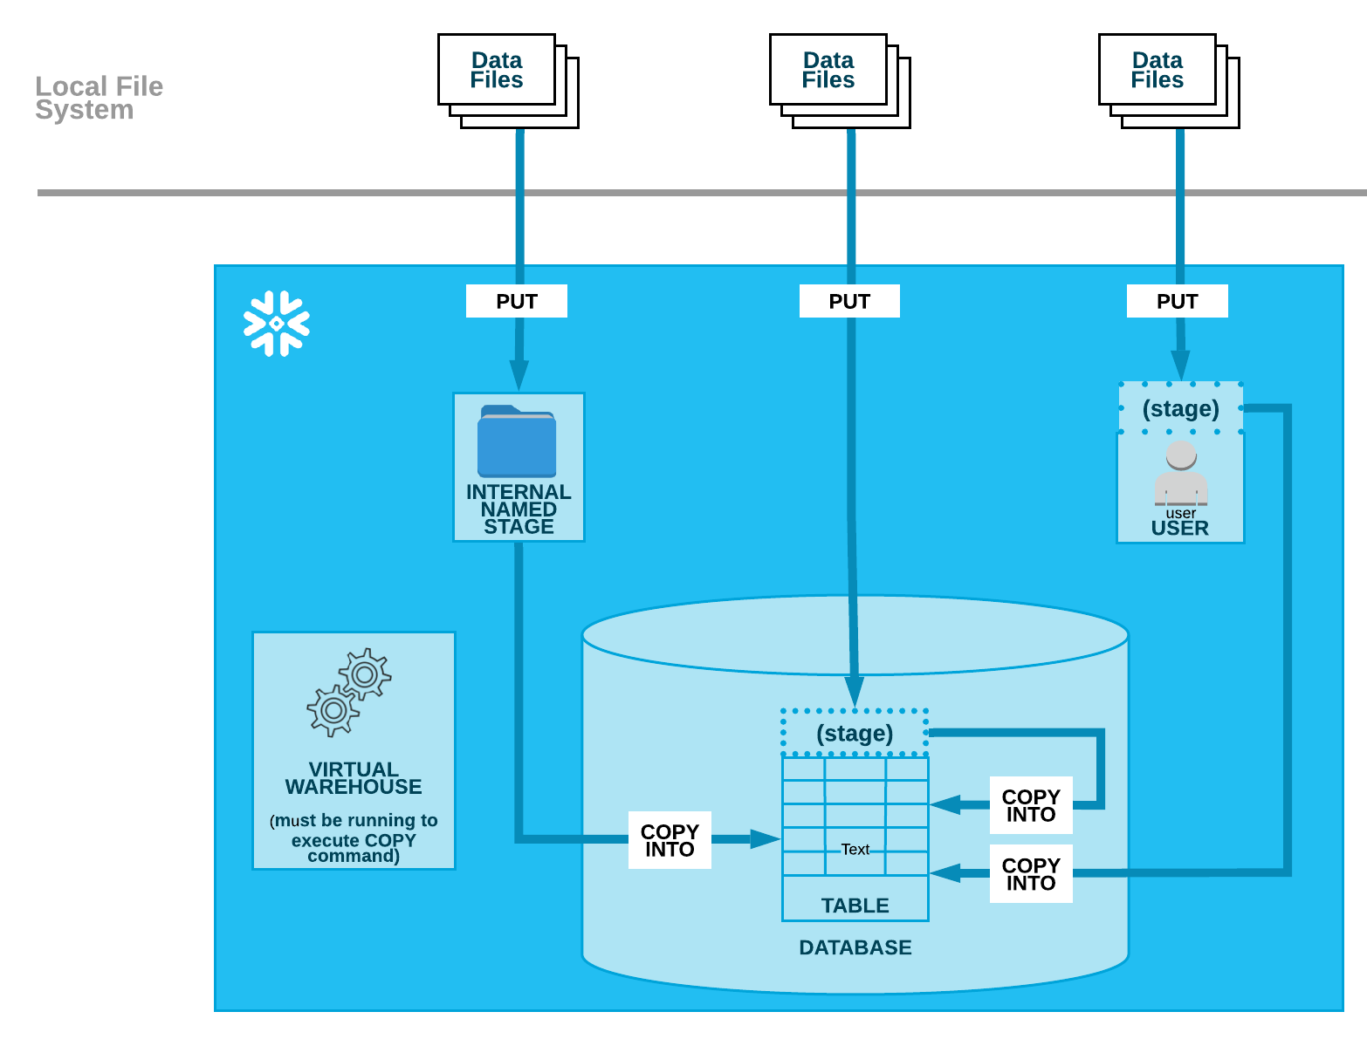
Data Loading from Internal Stage
Snowflake Internal Stages store data files internally within Snowflake
User Stage - Nation
Table Stage - LineItem and Customer
Named Internal Stage - Orders

Slide 10
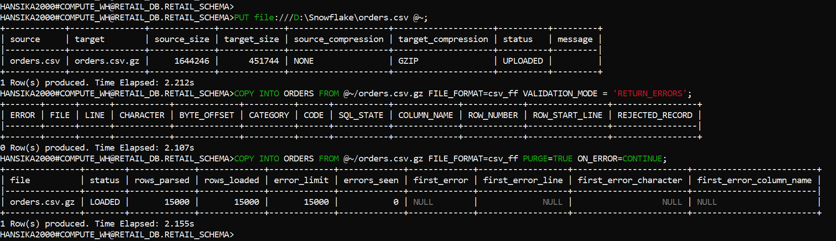
Data Loading from Internal Stage
Snowflake CLI loading using user stage

Slide 11
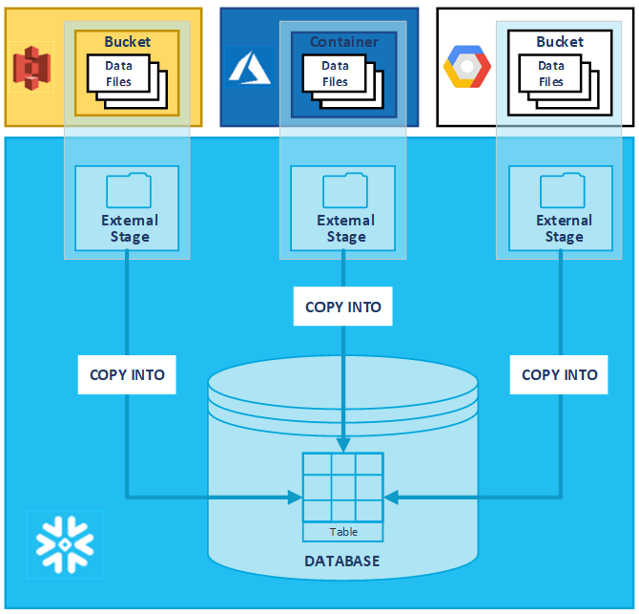
Data Loading from External Stage
External stages store files in an external location outside Snowflake environment
Upload files to S3 bucket
Create storage integration
Create external stage
Load files from external stage using COPY INTO command

Slide 12
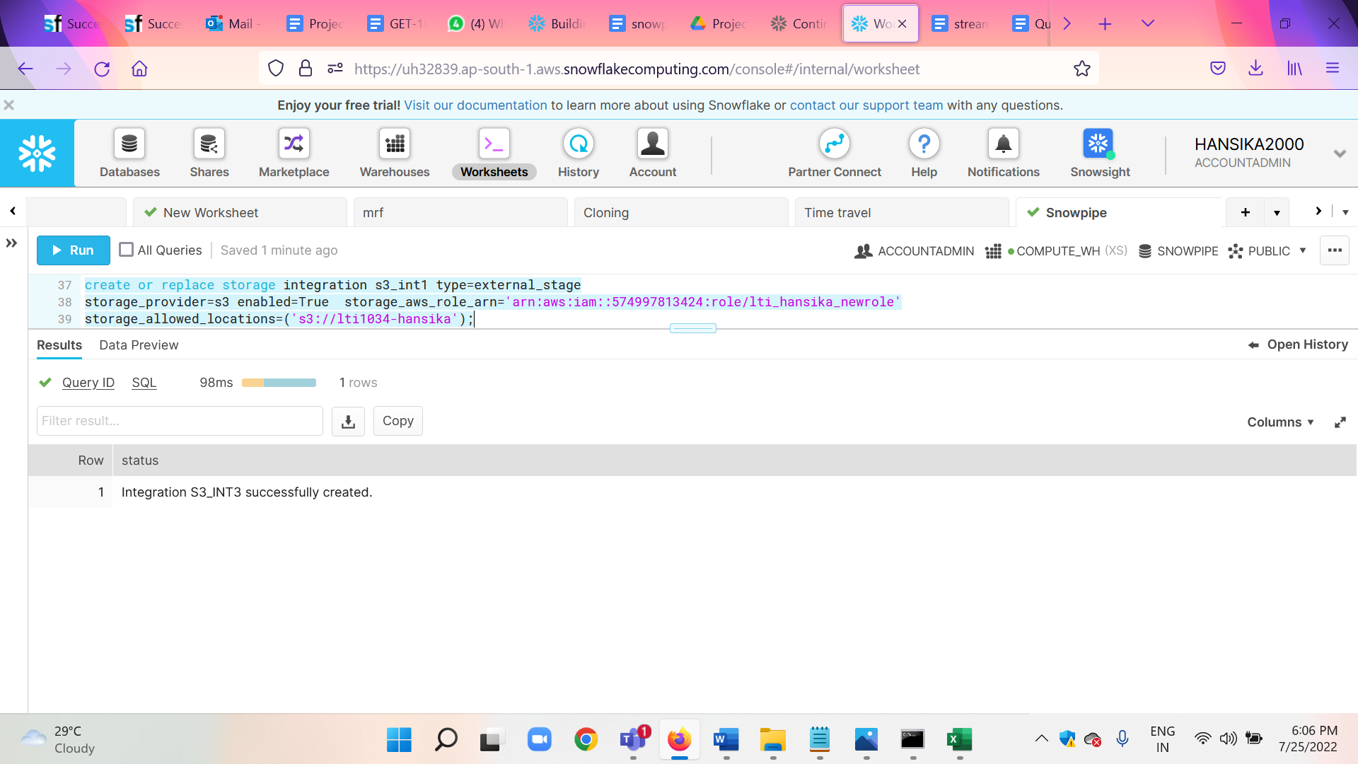
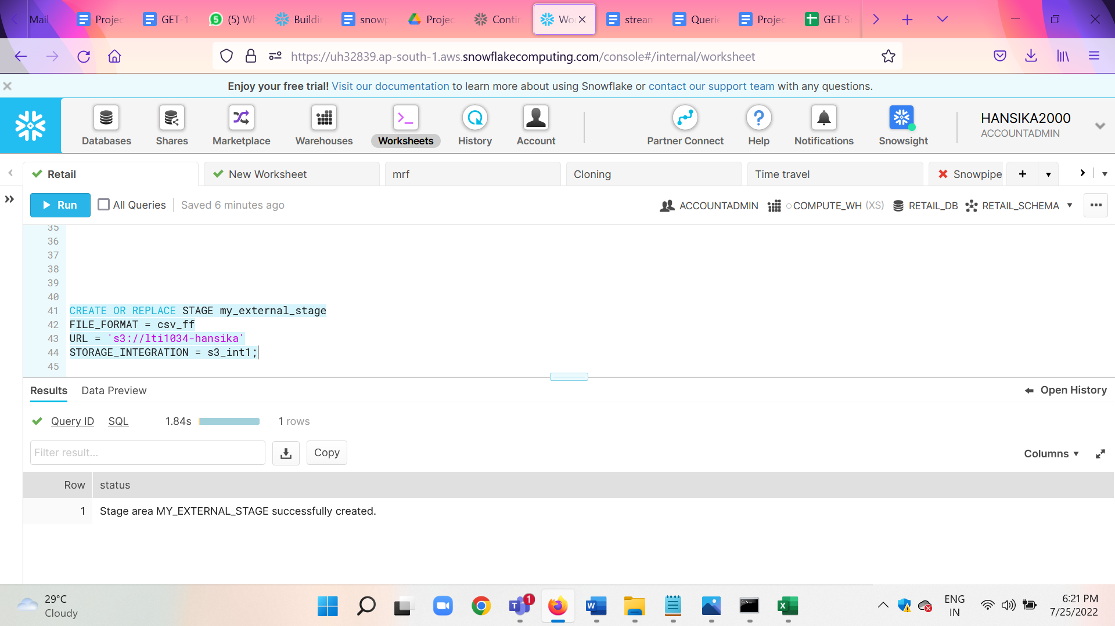
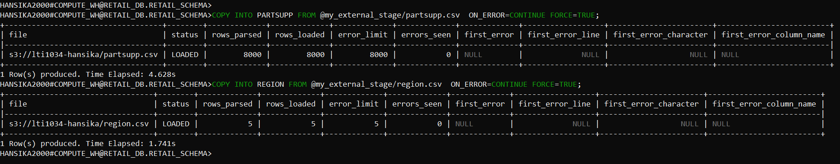
Data Loading from External Stage

Slide 13
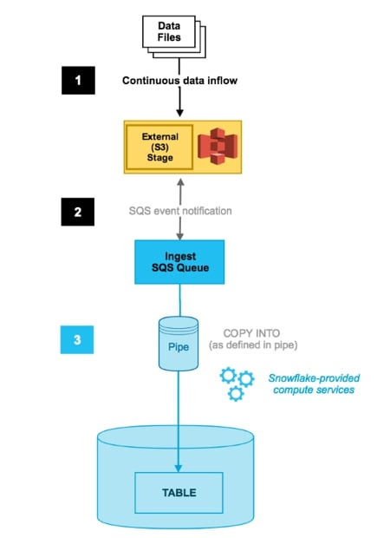
Continuous data loading using Snowpipe
Snowpipe enables loading data from files as soon as they're available in a stage. Snowpipe continuously loads micro-batches of data from an external stage location
Create an external S3 stage with storage integration
Create a pipe using CREATE PIPE with AUTO_INGEST=true
Set up the SQS notification
Upload a data file to the S3 bucket
Snowpipe snowpipe_orders loads table CDC_ORDERS

Slide 14
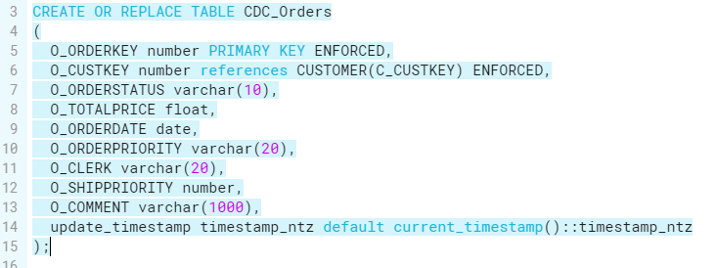
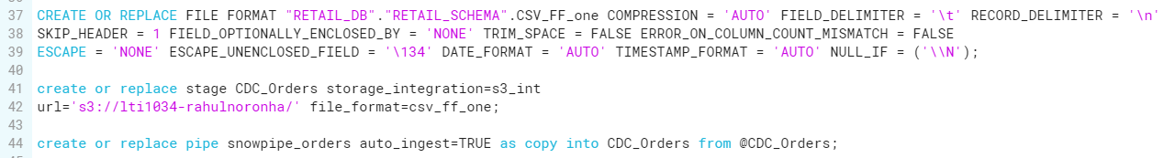
Continuous data loading using Snowpipe

Slide 15
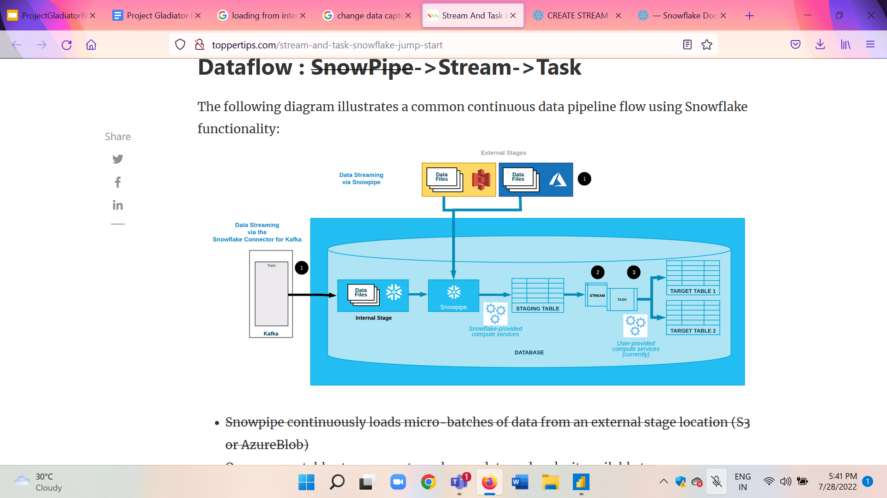
Change data capture using Stream
A stream object records DML changes made to tables, as well as metadata about each change, so that actions can be taken using the changed data
ORDERS_TABLE_CHANGES stream tracks changes in the table CDC_Orders
A task object defines a recurring schedule for executing a SQL statement. Tasks can be combined with table streams for continuous ELT workflows to process recently changed table rows
Changes are merged to the History table from the stream
Task populate_orders_history runs every two minutes to perform the merge operation

Slide 16
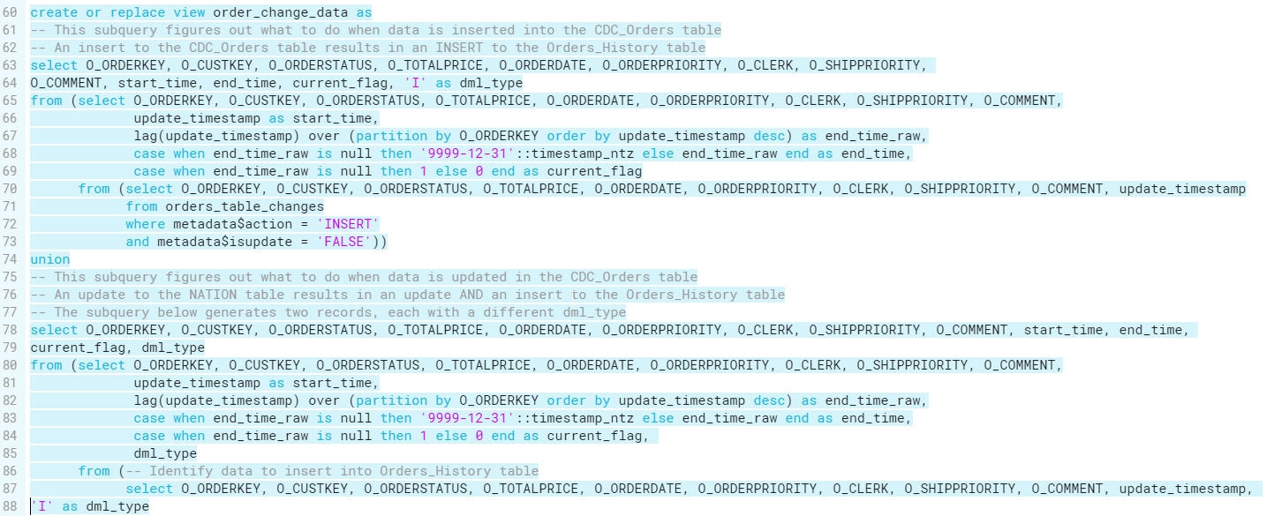
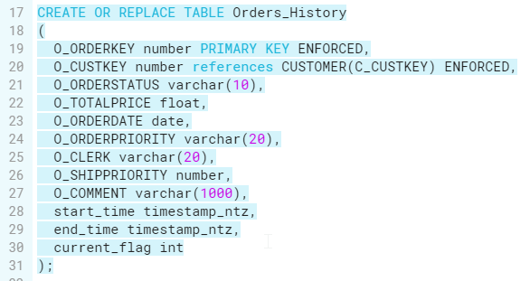
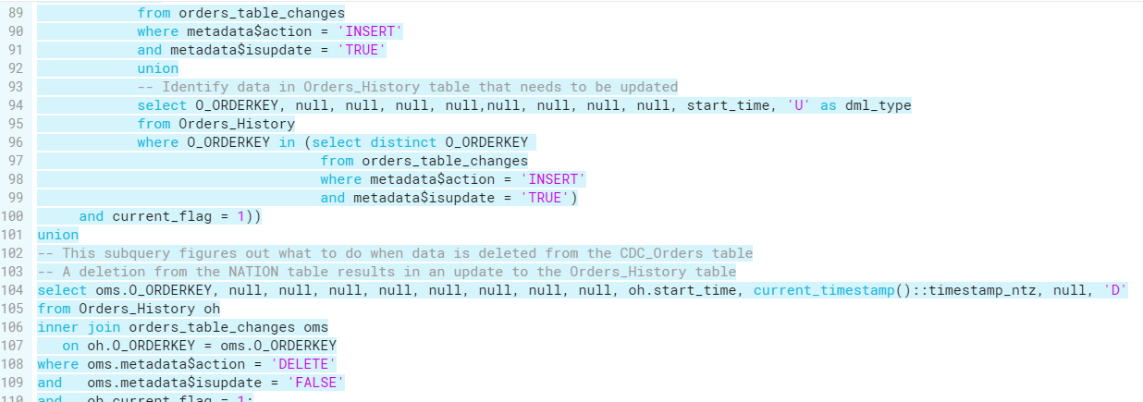
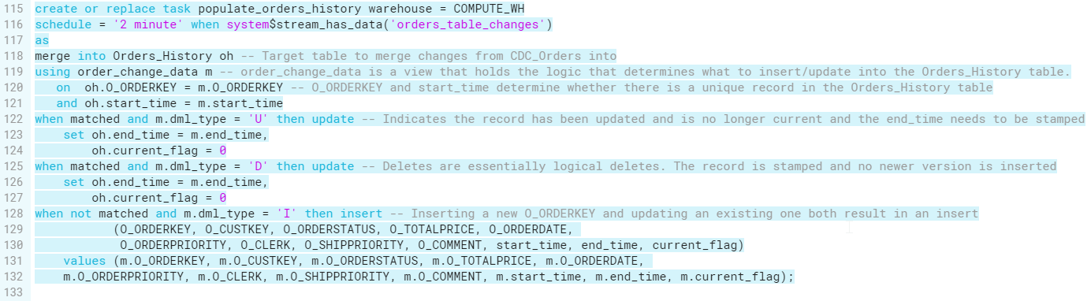
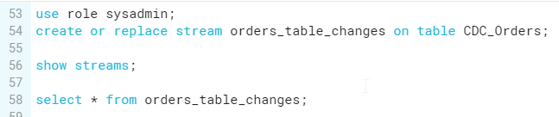
Change Data Capture using Stream

Slide 17
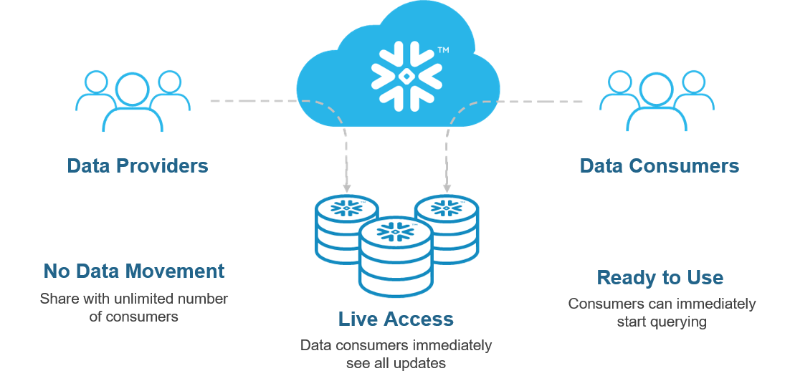
Secure Data Sharing
Secure Data Sharing enables sharing selected objects in a database in your account with other Snowflake accounts The following Snowflake database objects can be shared - Tables,External Tables,Secure views ,Secure Materialized views,Secure UDFs.Snowflake enables the sharing of databases through shares, which are created by data providers and “imported” by data consumers.All database objects shared between accounts are read-only (i.e. the objects cannot be modified or deleted, including adding or modifying table data).

Slide 18
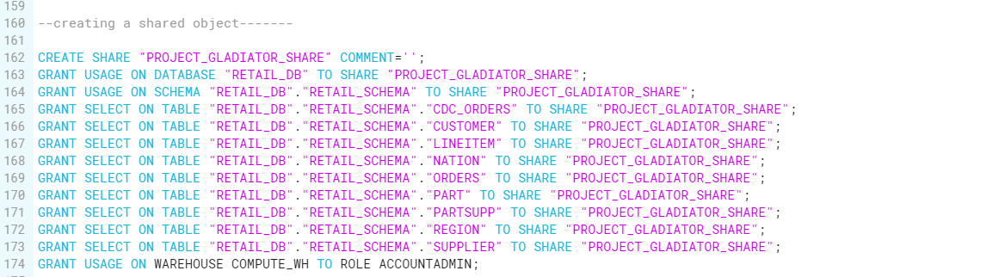
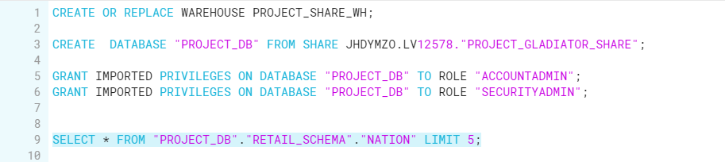
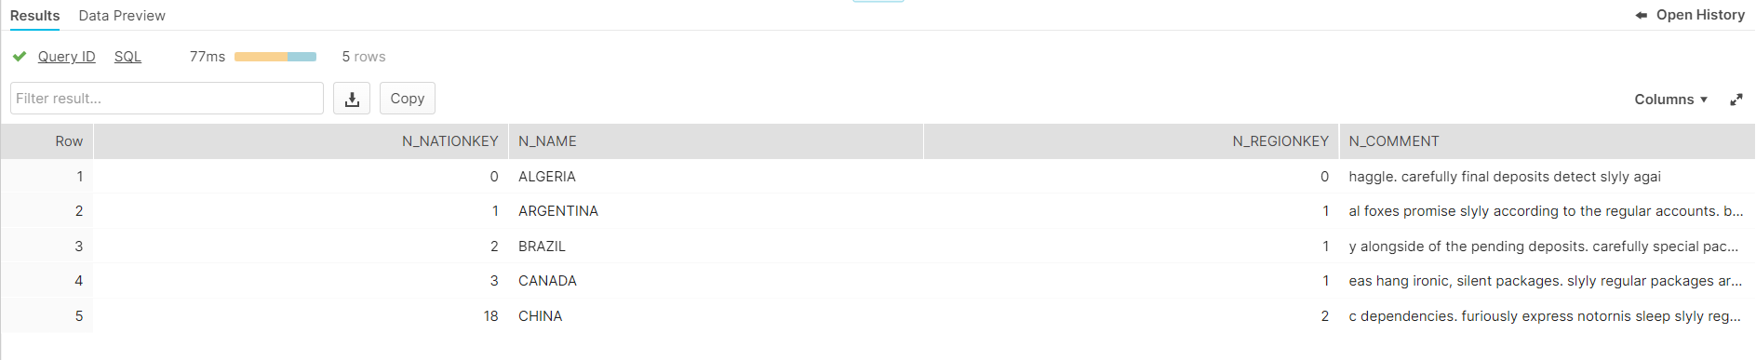
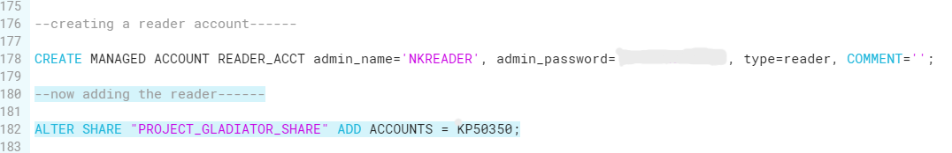
Secure Data Sharing
Snowflake commands to create reader account and share tables, database, schema with the new user

Slide 19
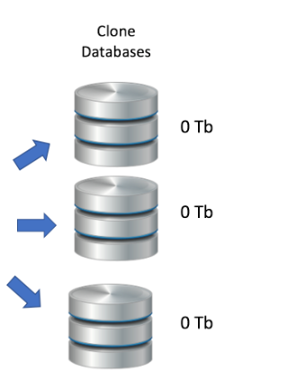
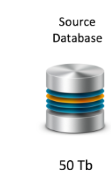
Zero Copy Cloning
Snowflake's zero-copy cloning feature provides a convenient way to quickly take a snapshot of any table. schema, or database and create a derived copy of that object which initially shares the underlying storage. This can be extremely useful for creating instant backups that do not incur any additional costs (until changes are made to the cloned object)

Slide 20
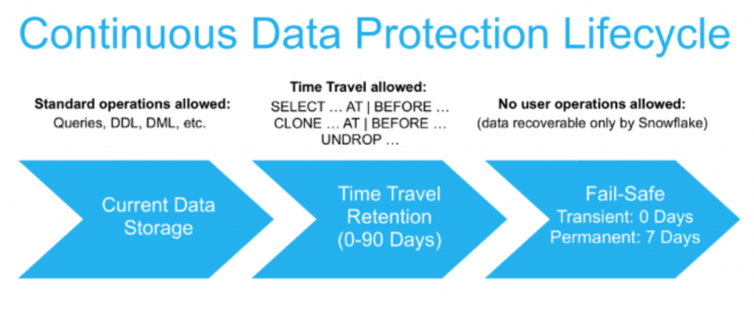
Continuous Data Protection
This encompasses a comprehensive set of features that help protect data stored in Snowflake against human error, malicious acts, and software or hardware failure. Querying, cloning, and restoring historical data in tables, schemas and databases for up to 90 days through Snowflake Time Travel
Disaster recovery of historical data (by Snowflake) through Snowflake Fall-safe.

Slide 21
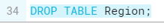
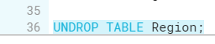
Zero Copy Cloning and Time Travel
Snowflake commands for zero copy cloning and time travel

Slide 22
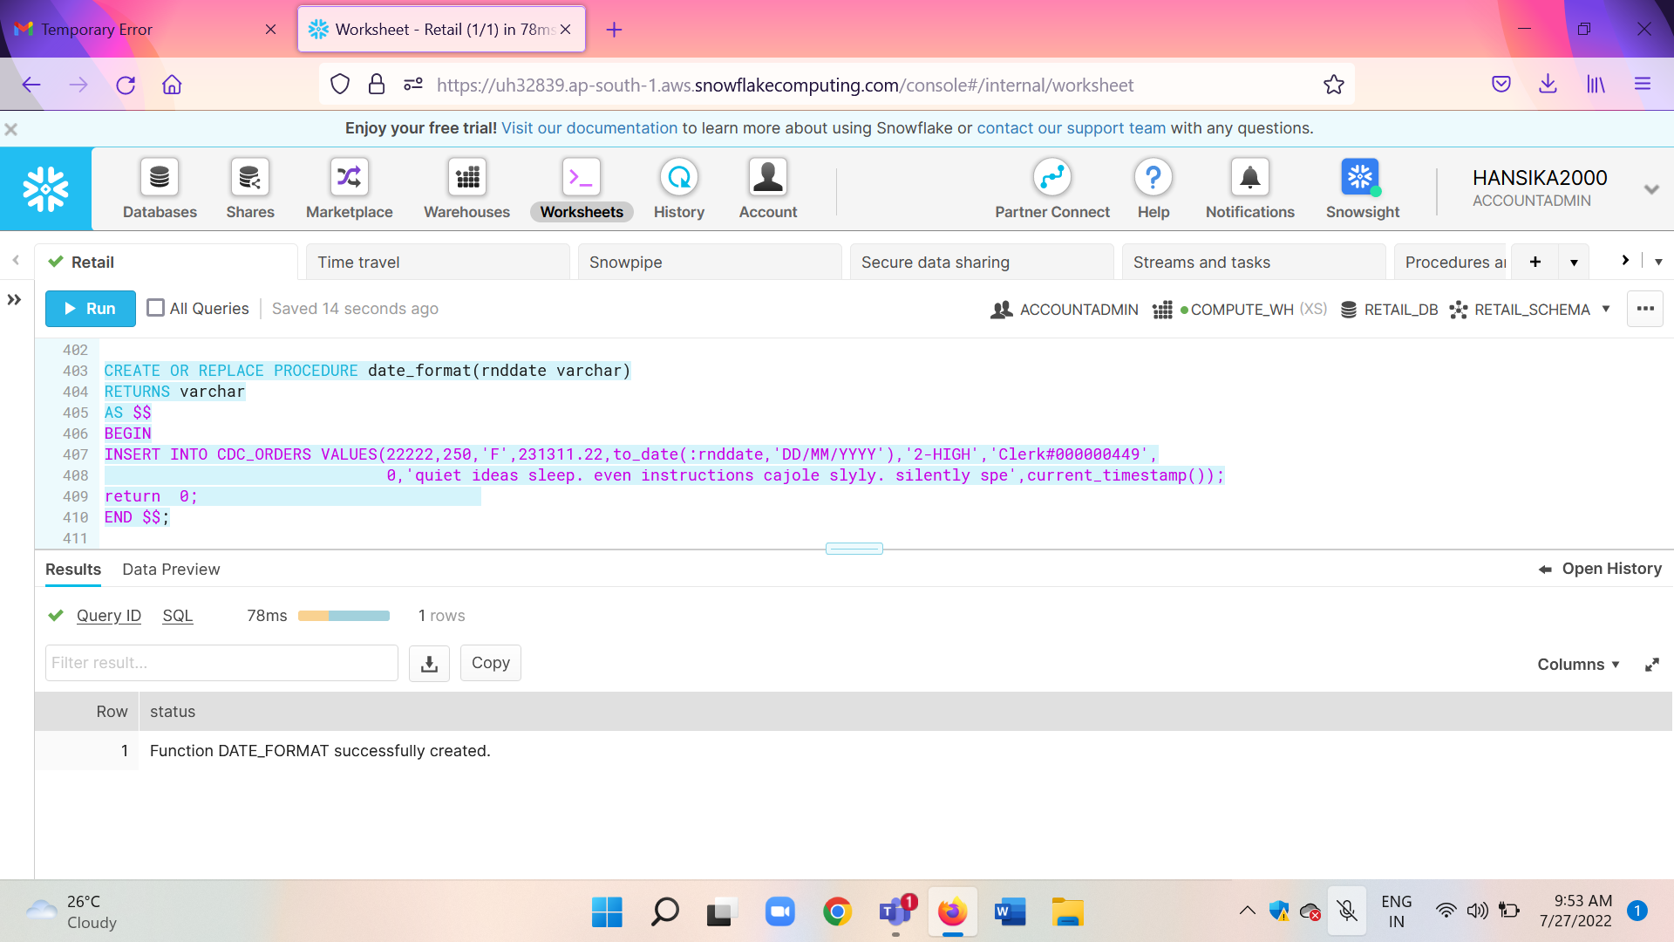
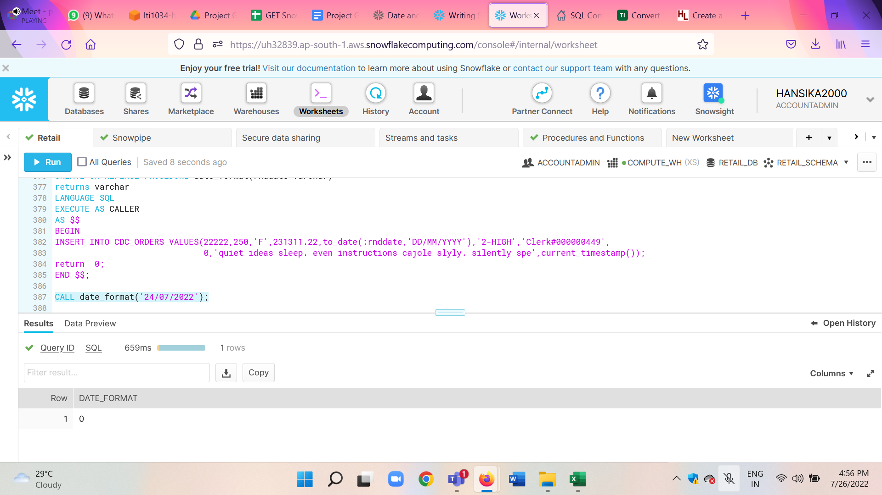
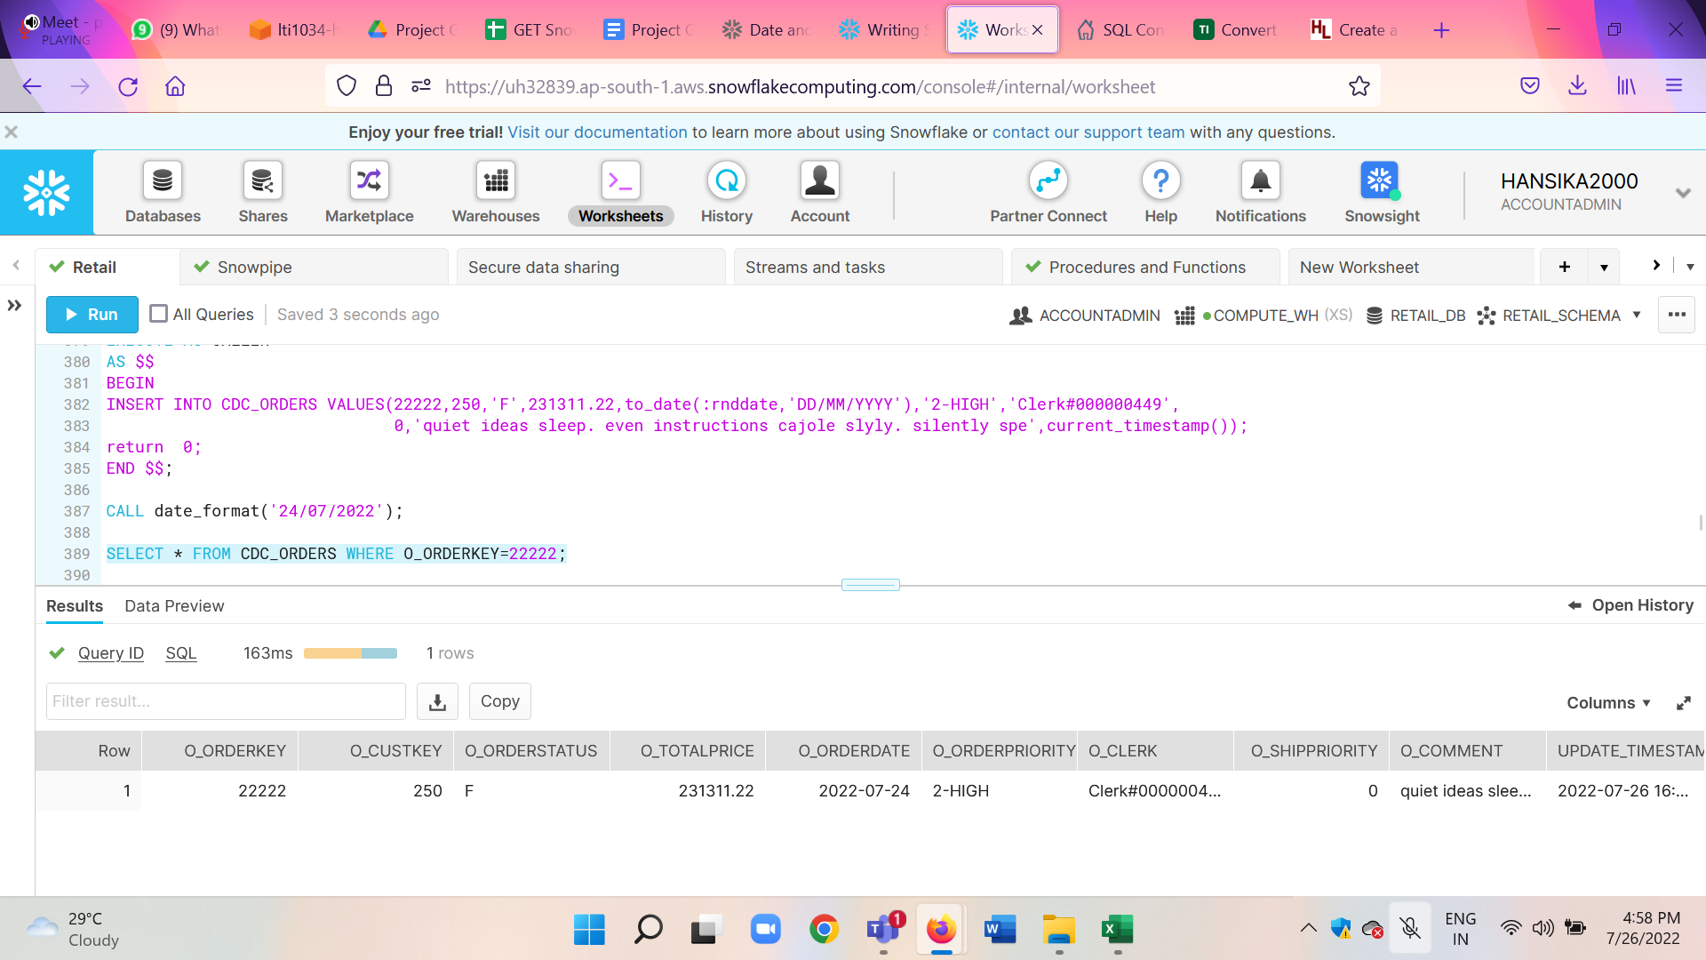
Stored Procedure
Stored procedures allow you to write procedural code that executes SQL. In a stored procedure, you can use programmatic constructs to perform branching and looping.
We create a stored procedure to typecast a string into date as shown below. So when the user passes the string into the stored procedure it is typecast into date in YYYY-MM-DD format and stored in O_ORDERDATE.

Slide 23
Challenges and Findings
The challenges faced and findings during this project are as follows:
Snowflake transformations needed to be done on some columns to make them more suitable for use.
Internal stage and external stage were used to load a part of the data tables.
The data tables were tab separated, so when loading it we set the record delimiter as ‘\t’.
Change Data capture was harder on the data since timestamp column was not being stored by the data collection source.
Also, note that the default constraint is not of much use because it only works when data is inserted using SQL commands, and Snowflake is not designed to let the default constraint work with data loading from snowpipe, and so the update_timestamp will show NULL until manual updates are done on the table. To tackle this issue we can ask the team to track the timestamp of updates as well.

Slide 24
Visualizations and Dashboards

Slide 25
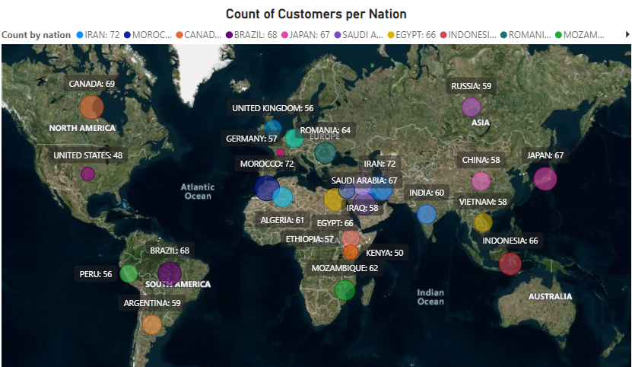
Customers per Nation

Slide 26
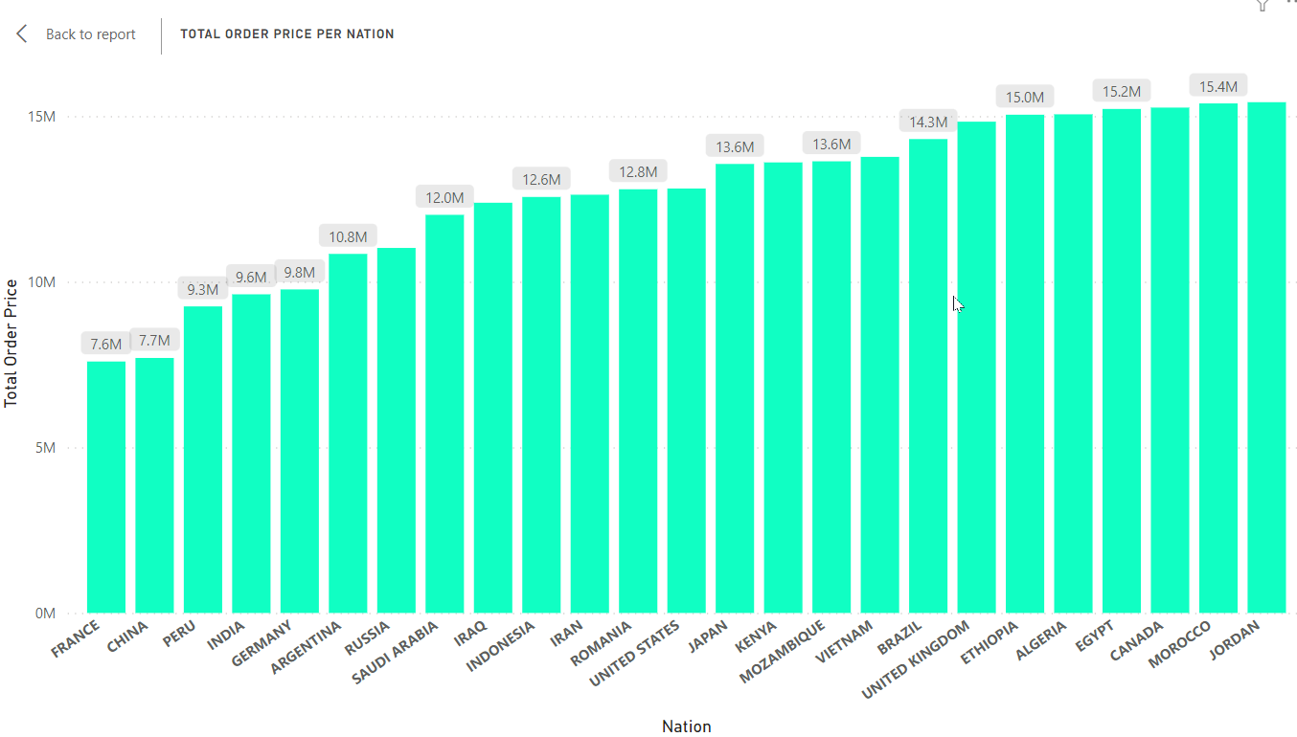
Total Order Price per Nation

Slide 27
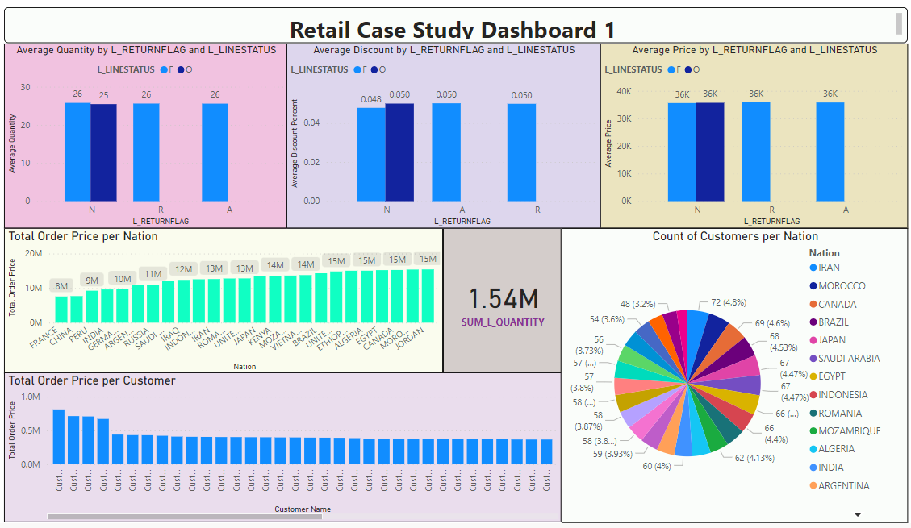

Slide 28
